Slide 1
Eskom Mini Project
Wesley Wienand 217047856
Infrastructure load balancing

Slide 2


Problem
In South Africa our national power supplier has difficulties of supplying power consistently.
Due to this South African Citizens experience “Load Shedding” or blackouts.

Slide 3
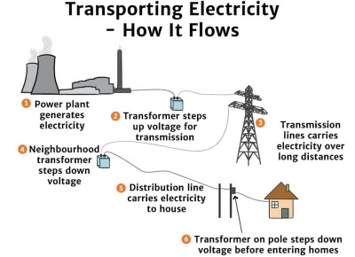
Eskom and South Africa
Classic electricity Transport scheme.
Eskom’s “electricity must be sent from the power stations to the load Centre’s”.
Load Centre is where demand is required.

Slide 4


Slide 5
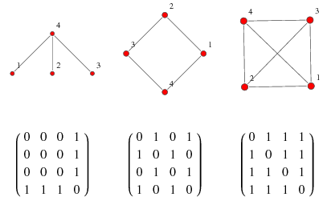
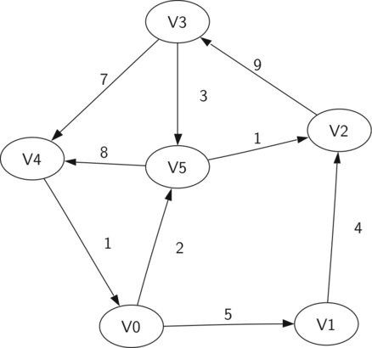
Graph ADT
Graph:
A Graph is a pair of vertices and edges.
Directed and Undirected graphs.
Adjacency List Structure .
Adjacency Matrix Structure .
Depth First Search
Breadth First Search
Deployment strategy

Slide 6
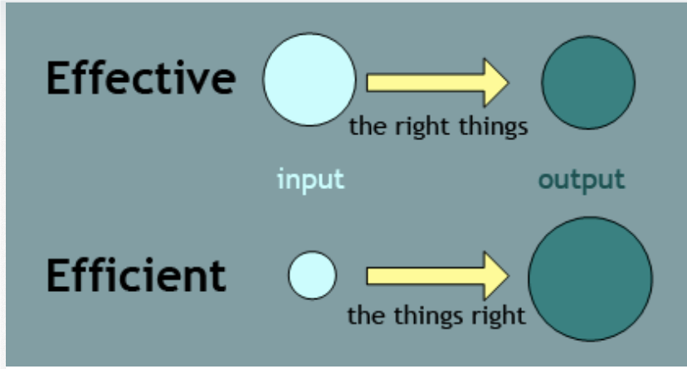

Solution
Load balancing Eskom.
Target:
Load Centre demand.
Coal Stations(Capacity and Production).
Output:
Efficient Load balancing solution.

Slide 7
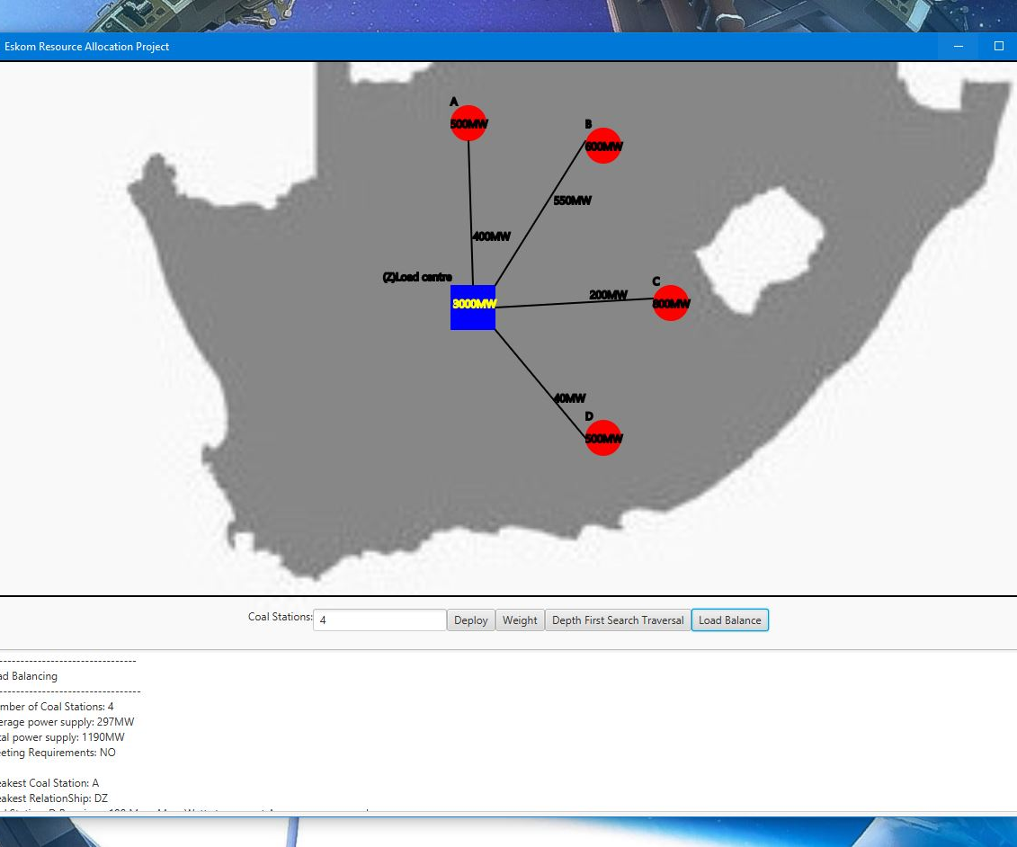
Project Legend
Red dot – Coal Station
Blue Square – Load Centre
Lines – Electricity lines

Slide 8


Slide 9
Implementation
Capture
Input Coal Stations , Weights, Costs.
Process
Creates graph, traverses and Calculates Load balance.
Output
Constructed graph.
Information needed for solution.

Slide 10


Slide 11
Project References
Pictures
https://www.scmdojo.com/wp-content/uploads/2018/10/Effective-vs-efficient-1.png
https://cdn.borntoengineer.com/2017/08/fi.png
https://www.solarschools.net/build/img/learn/energy/electricity/flow//transporting-electricity-diagram_400_resize_q95.jpg
https://rekordeast.co.za/wp-content/uploads/sites/85/2018/11/loadshedding_5822433_90566.jpg
https://businesstech.co.za/news/wp-content/uploads/2014/11/Eskom-broken-2.png
https://mathworld.wolfram.com/images/eps-gif/AdjacencyMatrix_1002.gif
https://cdn.shopify.com/s/files/1/0017/0432/9285/files/programming-quotes-for-developers-made4dev-simplicity.jpg?v=1539295142
Research
How Electricity Is Transmitted . 2020. How Electricity Is Transmitted . [ONLINE] Available at: http://www.eskom.co.za/AboutElectricity/ElectricityTechnologies/Pages/How_Electricity_Is_Transmitted.aspx. [Accessed 25 April 2020].
Wikipedia. 2020. Graph (abstract data type) - Wikipedia. [ONLINE] Available at: https://en.wikipedia.org/wiki/Graph_(abstract_data_type). [Accessed 25 April 2020].
Music
https://www.youtube.com/watch?v=Dle2KWu4hu4

Slide 12
